Slide 1
Session 1 Agentic AI & Agentic RAG "Evolution of AI agents
Notes:
Introduction to Session 1 Agentic AI & Agentic RAG "Evolution of AI agents
Core components of an AI agent
Planning, reasoning, and tool usage
Open AI Agents SDK
Agent architectures
CRAG (Corrective RAG)" 3 hrs
Lunch
Session 2 Agentic AI & Agentic RAG "Single-agent vs multi-agent systems
Building a simple AI agent (hands-on)
Multi-agent workflows with LangGraph
Different types of Agents and agentic handoff
" 3.5 hrs

Slide 2
Introduction to Agentic AI
Notes:
This section will provide an introduction to Agentic AI, exploring its fundamental concepts and significance in modern technologies. We will also outline the objectives of this session to guide our understanding.

Slide 3
Overview of Agentic AI
Agentic AI refers to systems with autonomous decision-making capabilities.
These systems can perform tasks without human intervention.
Agentic AI adapts to new information and changing environments.
Notes:
In this slide, we introduce the concept of Agentic AI, which is characterized by its ability to make autonomous decisions. This type of AI operates independently from human input, allowing it to perform tasks efficiently. Additionally, Agentic AI can adapt to new information and changes in its environment, making it highly versatile.

Slide 4
Importance in Modern Applications
Agentic AI enhances efficiency in industries like healthcare and finance.
It improves decision-making processes with real-time data analysis.
Facilitates the development of personalized user experiences.
Notes:
Agentic AI is pivotal in modern applications due to its ability to enhance efficiency across various industries, such as healthcare and finance. By leveraging real-time data analysis, Agentic AI improves decision-making processes. Additionally, it plays a critical role in creating personalized experiences for users, thus increasing engagement and satisfaction.

Slide 5
Session Objectives
Understand the basic principles of Agentic AI systems.
Explore the applications and benefits across sectors.
Identify challenges and future trends in Agentic AI.
Notes:
This slide outlines the objectives of our session. We aim to understand the foundational principles of Agentic AI systems. Furthermore, we will explore how these systems are applied across various sectors and the benefits they offer. Lastly, we will identify the challenges faced by Agentic AI today, as well as potential future trends.

Slide 6
Evolution of AI Agents
Notes:
This section will explore the evolution of AI agents, covering their historical progression, key milestones, and impact on modern technology.

Slide 7
Historical Progression of AI Agents
AI research began in the 1950s with simple algorithms.
Early AI focused on problem-solving and symbolic reasoning.
The 1970s saw the development of expert systems.
Notes:
The journey of AI began in the 1950s when researchers started exploring algorithms that could mimic human thought. Initially, the focus was on solving mathematical problems and symbolic reasoning. By the 1970s, expert systems, which are computer systems that emulate the decision-making ability of a human expert, marked a significant advancement.

Slide 8
AI Winter and Subsequent Revival
AI faced reduced funding and interest in the 1980s.
The 1990s saw a revival with improved algorithms.
Increased computing power boosted AI research.
Notes:
The 1980s experienced an 'AI winter' due to unmet expectations and limited funding. However, the 1990s marked a revival. Enhanced algorithms and increased computing power rekindled interest and investment in AI research, paving the way for more sophisticated systems.

Slide 9
Key Milestone: Deep Learning Emergence
Deep learning emerged in the early 2000s.
Neural networks became more complex and effective.
Applications in image and speech recognition.
Notes:
The early 2000s saw the rise of deep learning, a subset of machine learning that uses neural networks with many layers. This advancement allowed for more complex and effective processing capabilities. Deep learning revolutionized fields like image and speech recognition, setting new standards for AI performance.

Slide 10
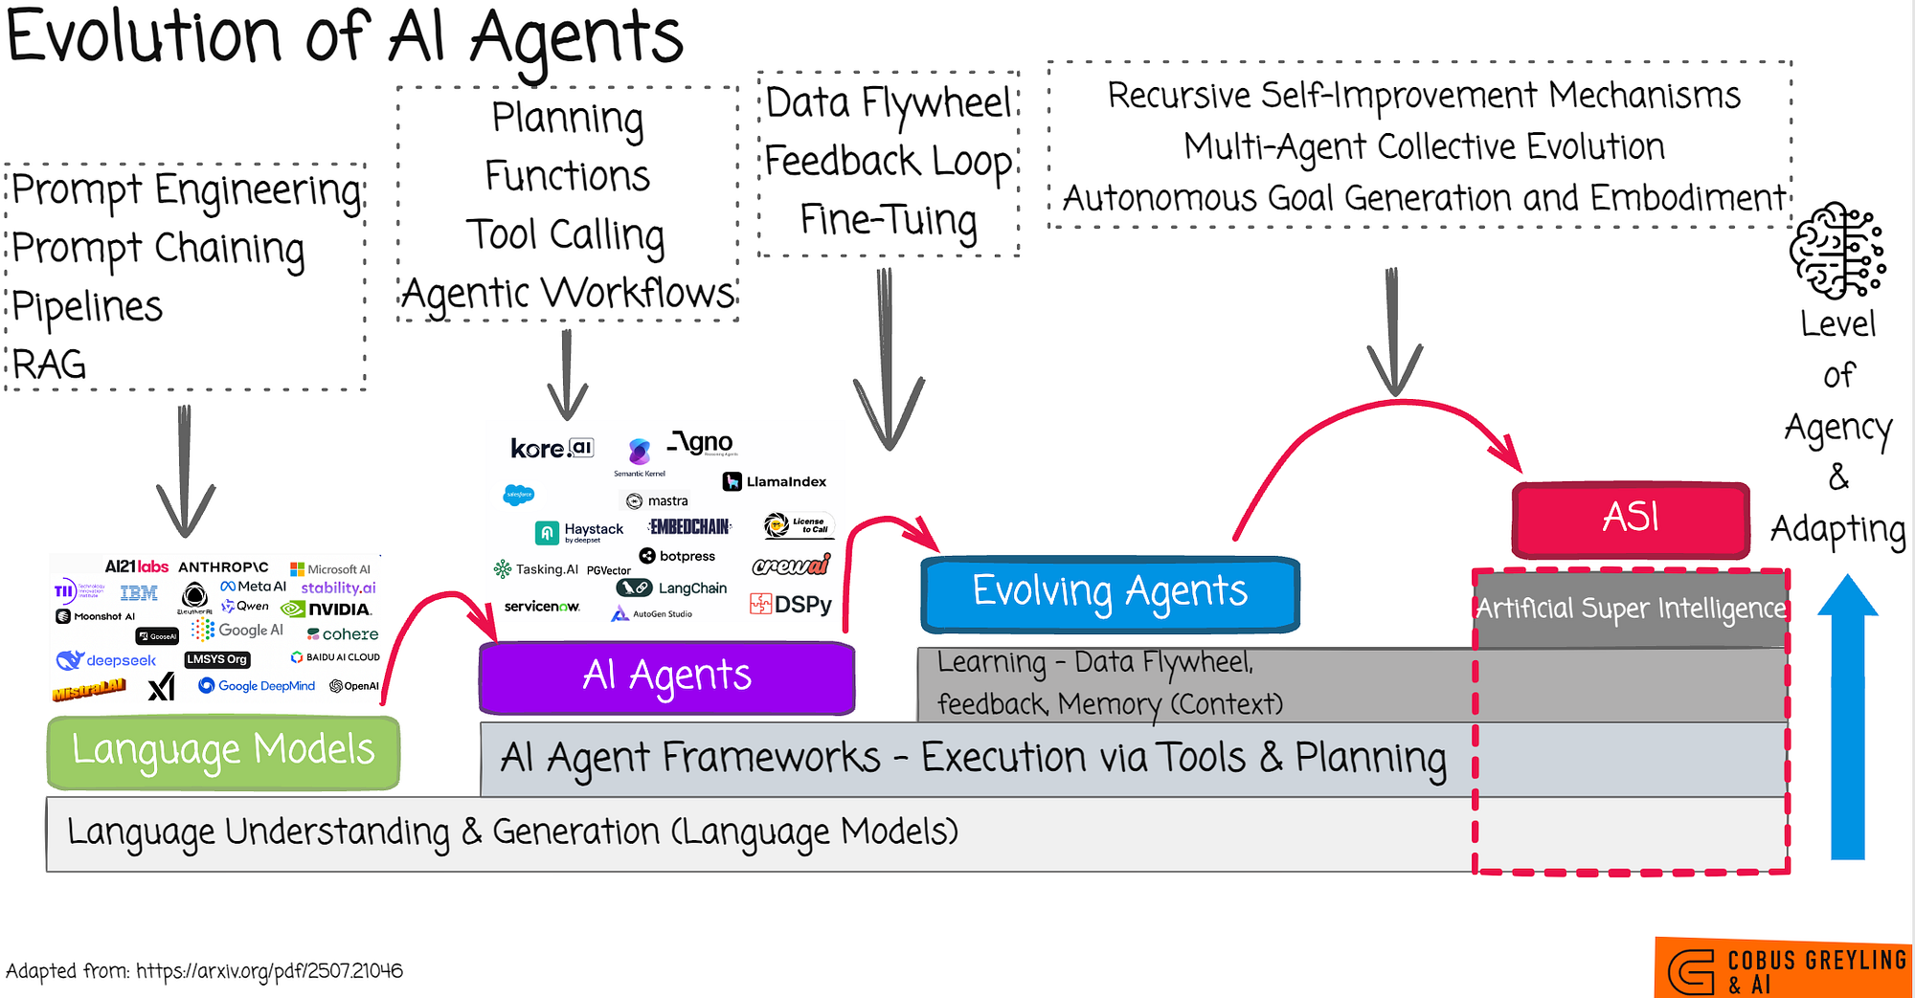
Notes:
Looking ahead, AI is expected to continue evolving, with increased focus on ethical considerations such as bias and privacy. There's potential for AI to revolutionize sectors yet untouched by its capabilities. Current research efforts are also directed at enhancing the interaction between AI systems and humans, aiming for more seamless and intuitive interfaces.

Slide 11
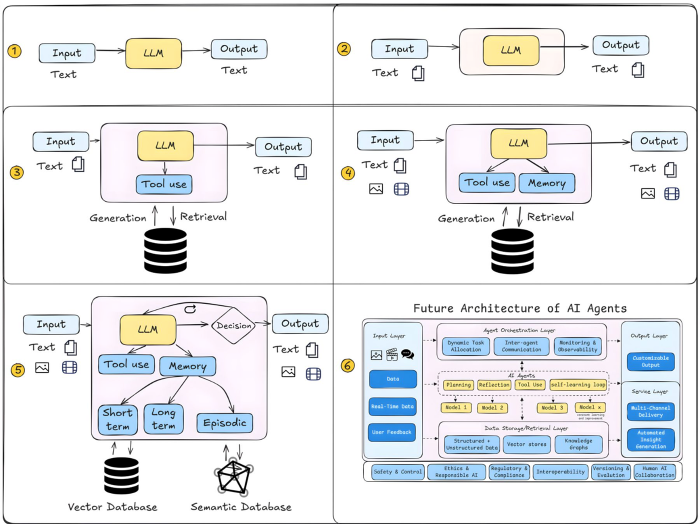
Notes:
AI has become a cornerstone in various industries, including healthcare, where it aids in diagnostics, and finance, where it enhances decision-making through data analytics. Automation powered by AI is boosting productivity, and AI personal assistants have become a ubiquitous part of daily life, aiding users with tasks and information.

Slide 12
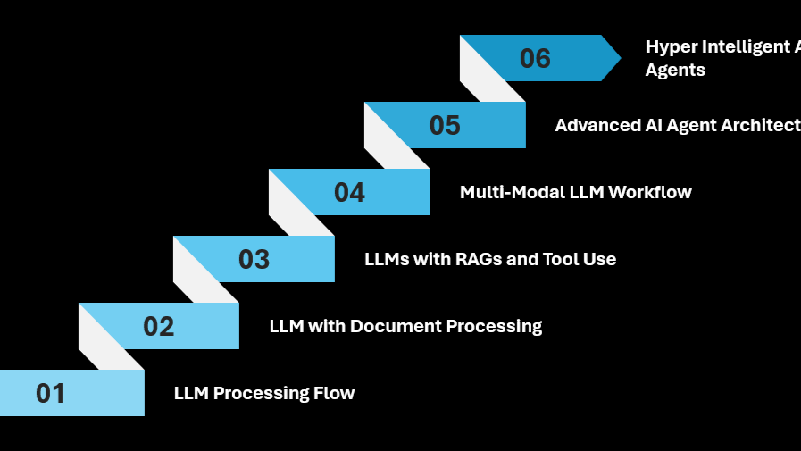
Notes:
A significant milestone in AI was achieved in 2016 when AlphaGo, developed by DeepMind, defeated the world champion Go player, Lee Sedol. This victory was attributed to advanced neural networks and reinforcement learning techniques, highlighting AI's capability to excel in intricate strategic environments.

Slide 13
Core Components of an AI Agent
Notes:
In this section, we will explore the fundamental components that make up an AI agent. These include perception and sensing, decision-making processes, action and interaction, and learning mechanisms. Each component plays a crucial role in the functionality and efficiency of AI systems.

Slide 14
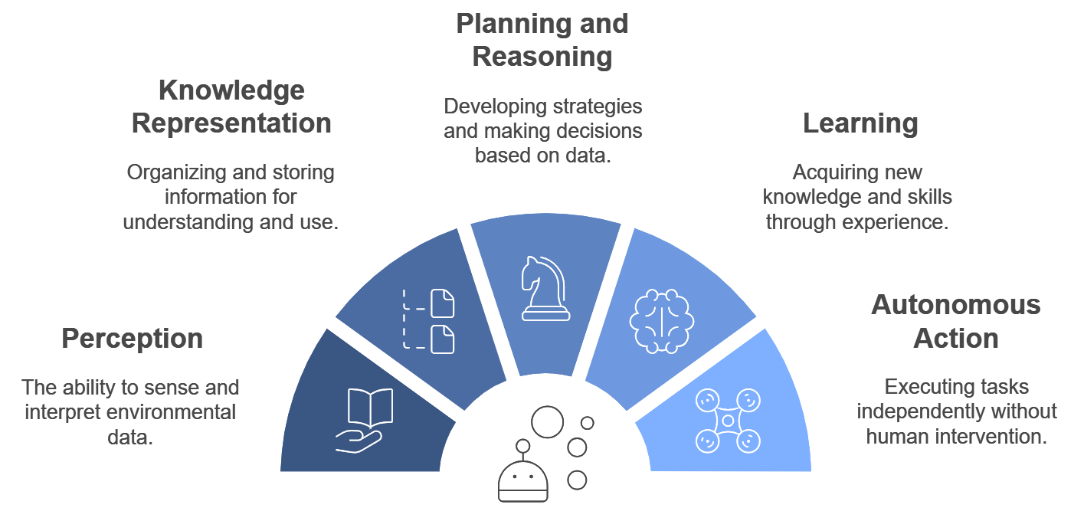
Notes:
In this section, we will explore the fundamental components that make up an AI agent. These include perception and sensing, decision-making processes, action and interaction, and learning mechanisms. Each component plays a crucial role in the functionality and efficiency of AI systems.

Slide 15
Understanding Perception and Sensing
Perception involves gathering data from the environment.
Sensors capture visual, auditory, and other data types.
Data quality affects AI's ability to perceive accurately.
Notes:
Perception and sensing are fundamental for an AI agent to interpret its surroundings. Various sensors are used to collect data, which can include images, sounds, and other signals. The quality and accuracy of this data are critical for effective perception.

Slide 16
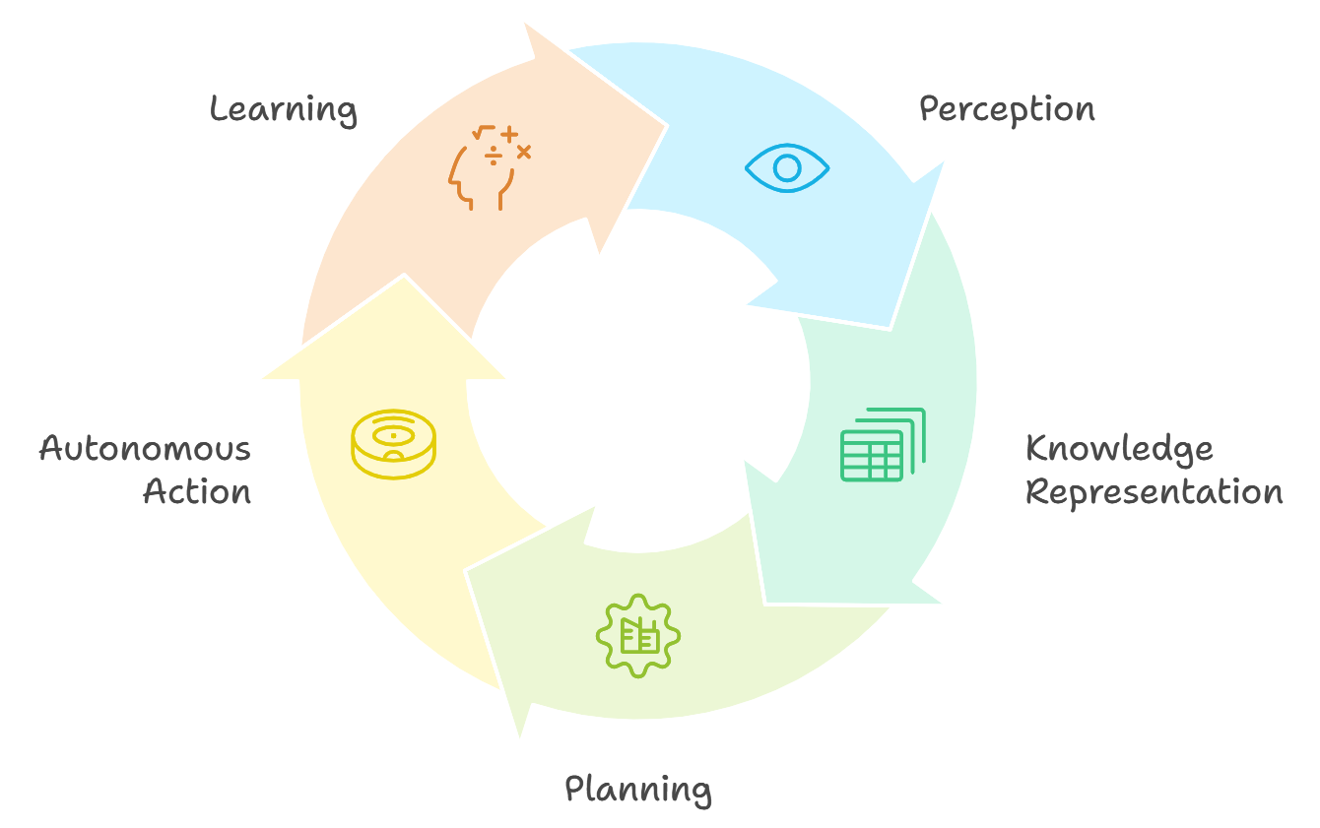
Notes:
In this section, we will explore the fundamental components that make up an AI agent. These include perception and sensing, decision-making processes, action and interaction, and learning mechanisms. Each component plays a crucial role in the functionality and efficiency of AI systems.

Slide 17
Decision-Making Processes in AI
Algorithms evaluate data to make informed decisions.
Rule-based systems use predefined logic.
Machine learning adapts to new data over time.
Notes:
AI agents employ decision-making processes to analyze data and choose actions. Algorithms are used to evaluate information, with rule-based systems relying on predefined logic. Machine learning enables AI to improve decisions by adapting to new data inputs over time.

Slide 18
Approaches to AI Decision-Making
Heuristic methods simplify complex problems.
Probabilistic models handle uncertainty in data.
Neural networks excel in pattern recognition.
Notes:
Different approaches to decision-making in AI include heuristic methods, which simplify complex issues, and probabilistic models, which manage data uncertainty. Neural networks are particularly effective for recognizing patterns, making them useful in various AI applications.

Slide 19
Action and Interaction in AI Systems
AI agents execute actions based on decisions.
Interactions can be with humans or other systems.
Feedback loops improve system performance.
Notes:
Once decisions are made, AI agents perform actions, which can involve interactions with humans or other systems. These interactions are crucial for tasks such as customer service or collaborative robotics. Feedback loops from these interactions help refine system performance.

Slide 20
Learning Mechanisms in AI Agents
Supervised learning uses labeled data for training.
Unsupervised learning finds patterns in unlabeled data.
Reinforcement learning optimizes actions via rewards.
Notes:
AI agents employ various learning mechanisms to enhance their capabilities. Supervised learning involves training with labeled datasets, while unsupervised learning identifies patterns without labels. Reinforcement learning focuses on optimizing actions through reward-based systems.

Slide 21
Advancements in AI Learning Technologies
Deep learning drives advancements in AI capabilities.
Transfer learning applies knowledge across tasks.
Continuous learning enables ongoing adaptation.
Notes:
Recent advancements in AI learning technologies have significantly enhanced capabilities. Deep learning has been a key driver, enabling complex problem-solving. Transfer learning allows AI to apply knowledge from one task to another, while continuous learning supports ongoing adaptation and improvement.

Slide 22
Agent Architectures and SDKs
Notes:
This section introduces the key concepts and tools for developing agent architectures using various SDKs. We will explore different architectural patterns and review case studies to understand practical applications.

Slide 23
Open AI Agents SDK Overview
Provides tools for building intelligent agents
Supports integration with multiple AI models
Facilitates rapid prototyping of agent solutions
Notes:
The Open AI Agents SDK is a comprehensive toolkit designed for developing intelligent agents. It allows seamless integration with various AI models, enabling developers to prototype and deploy solutions efficiently.

Slide 24
Key Features of Open AI Agents SDK
Modular architecture for flexibility
Built-in support for natural language processing
Extensive documentation and community support
Notes:
The Open AI Agents SDK boasts a modular architecture, allowing developers to customize and extend functionalities. It supports natural language processing and has extensive resources and community support to aid development.

Slide 25
Architectural Patterns in AI Agents
Reactive vs. deliberative architectures
Hybrid architectures for complex tasks
Role of feedback loops in agent design
Notes:
Architectural patterns play a crucial role in agent design. Reactive and deliberative architectures serve different needs, while hybrid architectures combine both to handle complex tasks. Feedback loops enhance learning and adaptability.

Slide 26
Case Study: AI Agent in Customer Service
Implemented using Open AI Agents SDK
Reduced response time by 40%
Improved customer satisfaction scores
Notes:
This case study highlights the implementation of an AI agent in a customer service setting using the Open AI Agents SDK. It successfully reduced response times and improved customer satisfaction, demonstrating the SDK's efficacy.

Slide 27
Case Study: AI Agent in Healthcare
Assists in patient diagnosis and monitoring
Integrates with electronic health records
Enhances accuracy of diagnosis recommendations
Notes:
In healthcare, AI agents developed using the Open AI Agents SDK assist with patient diagnosis and monitoring. By integrating with electronic health records, these agents provide more accurate diagnosis recommendations, improving patient outcomes.

Slide 28
Planning, Reasoning, and Tool Usage
Notes:
In this section, we will explore strategic planning, logical reasoning, and effective tool integration. This foundation supports making informed decisions and enhancing productivity.

Slide 29
Understanding Strategic Planning
Define clear objectives and goals.
Identify resources and constraints.
Develop a timeline for implementation.
Notes:
Strategic planning involves setting objectives to guide your organization. It's crucial to understand available resources, constraints, and to map out a timeline for execution.

Slide 30
Key Elements of Logical Reasoning
Identify premises and conclusions.
Evaluate the validity of arguments.
Use deductive and inductive reasoning.
Notes:
Logical reasoning is essential for sound decision-making. It involves identifying premises, evaluating argument validity, and applying deductive or inductive reasoning to draw conclusions.

Slide 31
Integrating Tools in Planning
Select tools based on project needs.
Ensure compatibility with existing systems.
Provide training for effective usage.
Notes:
Effective tool integration requires selecting appropriate tools that meet project needs, ensuring compatibility, and providing necessary training to maximize tool utility and efficiency.

Slide 32
Benefits of Strategic Tool Usage
Enhances efficiency and productivity.
Improves data management and analysis.
Facilitates better communication.
Notes:
Strategic use of tools leads to enhanced efficiency and productivity, improved data management, and better communication across teams, contributing to overall organizational success.

Slide 33
Challenges in Tool Integration
Resistance to change from employees.
Integration with legacy systems.
Continuous updates and maintenance.
Notes:
Integrating new tools can present challenges such as resistance to change, compatibility with legacy systems, and the need for ongoing updates and maintenance to ensure smooth operation.

Slide 34
Corrective RAG (CRAG) Overview
Notes:
This section introduces the concept of Corrective RAG, or CRAG. It will provide an overview, discuss implementation strategies, and explore various applications. CRAG is a powerful tool used in project management to monitor, assess, and rectify issues effectively.

Slide 35
Introduction to Corrective RAG
CRAG is a project management tool for corrective actions.
Uses a color-coded system: Red, Amber, Green.
Enables quick identification and resolution of issues.
Notes:
In this slide, we introduce Corrective RAG, a tool that helps in managing projects by assigning colors to indicate the status of specific areas. Red indicates critical issues, Amber suggests caution, and Green means everything is on track. This system facilitates quick decision-making and prioritization of tasks.

Slide 36
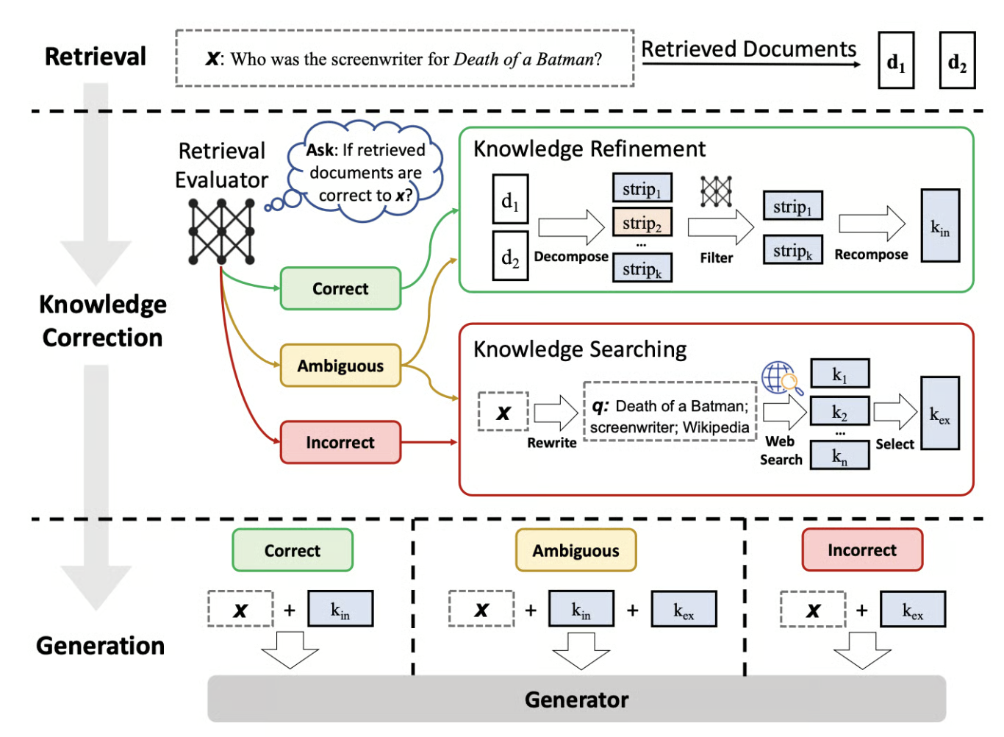
Notes:
In this slide, we introduce Corrective RAG, a tool that helps in managing projects by assigning colors to indicate the status of specific areas. Red indicates critical issues, Amber suggests caution, and Green means everything is on track. This system facilitates quick decision-making and prioritization of tasks.

Slide 37
Key Benefits of Implementing CRAG
Improves visibility of project health and status.
Facilitates proactive issue resolution.
Enhances communication among stakeholders.
Notes:
Implementing CRAG offers several benefits. It provides clear visibility into the project's health, allowing managers to address issues before they escalate. Additionally, it fosters better communication among team members and stakeholders by providing a clear, visual representation of project status.

Slide 38
Strategies for Effective CRAG Implementation
Define clear criteria for each RAG status.
Regularly update status based on predefined metrics.
Engage stakeholders in the CRAG process.
Notes:
To effectively implement CRAG, it's crucial to define clear criteria for what constitutes Red, Amber, or Green status. Regular updates using these criteria ensure accurate tracking. Engaging stakeholders in the process ensures everyone is aligned and understands the project's priorities and challenges.

Slide 39
Applications of CRAG in Project Management
Used in risk management to identify potential issues.
Helps track progress and performance against goals.
Supports decision-making with visual status indicators.
Notes:
CRAG is widely used in project management to manage risks by identifying potential issues early. It assists in tracking progress against set goals and performance metrics, providing a visual status that supports informed decision-making. This application ensures projects stay on track and goals are met efficiently.

Slide 40
Single-agent vs Multi-agent Systems
Notes:
In this section, we will explore the differences between single-agent and multi-agent systems, examining their characteristics, benefits, challenges, and real-world applications.

Slide 41
Comparative Analysis of Agent Systems
Single-agent systems focus on individual task completion.
Multi-agent systems coordinate among multiple agents.
Complexity increases with number of agents in the system.
Notes:
This slide provides a comparative analysis of single-agent and multi-agent systems. Single-agent systems typically handle tasks independently, while multi-agent systems involve coordination among multiple agents, adding complexity. Understanding these distinctions is crucial for selecting the appropriate system for specific tasks.

Slide 42
Benefits of Single-agent Systems
Simpler design and implementation.
Easier to manage and debug.
Lower resource requirements compared to multi-agent.
Notes:
Single-agent systems offer several benefits, including simpler design and implementation processes. They are generally easier to manage and debug, making them suitable for straightforward tasks. Additionally, they require fewer resources, which can be advantageous in resource-constrained environments.

Slide 43
Challenges of Multi-agent Systems
Increased complexity in coordination.
Potential for communication overhead.
Difficulty in ensuring global system efficiency.
Notes:
Multi-agent systems present challenges such as increased complexity in coordinating multiple agents. Communication overhead can also be significant, and ensuring the efficiency of the entire system can be difficult. These challenges must be addressed for successful implementation.

Slide 44
Use Cases for Single-agent Systems
Effective in environments with static tasks.
Ideal for scenarios with limited complexity.
Suitable for tasks with clear and defined goals.
Notes:
Single-agent systems are particularly effective in environments where tasks are static and well-defined. They are ideal for scenarios with limited complexity and clear objectives, making them a good choice for specific, unchanging tasks.

Slide 45
Use Cases for Multi-agent Systems
Applicable in dynamic and complex environments.
Useful for tasks requiring collaboration.
Ideal for distributed problem-solving scenarios.
Notes:
Multi-agent systems excel in dynamic and complex environments where collaboration is necessary. They are particularly useful for distributed problem-solving tasks, where multiple agents can work together to achieve a common goal. This makes them suitable for a variety of real-world applications.

Slide 46
Building and Managing AI Agents
Notes:
This section introduces the process of developing and managing AI agents. We'll explore hands-on development, advanced workflows, and handoff techniques to ensure smooth operation and integration of AI agents in various environments.

Slide 47
Hands-on AI Agent Development Essentials
Understand AI agent architectures and models
Implement foundational algorithms and techniques
Utilize development tools for efficient coding
Notes:
This slide focuses on the essentials of hands-on AI agent development. We'll discuss the core architectures and models used in AI agents, explore foundational algorithms, and review the key development tools that enhance coding efficiency.

Slide 48
Setting Up Development Environments
Choose appropriate development frameworks
Ensure compatibility with AI libraries and tools
Optimize for collaborative coding and testing
Notes:
Setting up the right development environment is critical for AI agent success. This slide covers choosing suitable frameworks, ensuring compatibility with AI libraries, and optimizing environments for collaboration and testing.

Slide 49
Managing Multi-agent Workflows with LangGraph
Integrate LangGraph for seamless workflows
Coordinate tasks among multiple agents
Monitor and optimize agent interactions
Notes:
LangGraph plays a pivotal role in managing multi-agent workflows. We will look into how LangGraph facilitates task coordination, enables seamless workflows, and helps in monitoring and optimizing interactions among agents.

Slide 50
Agentic Handoff Techniques in AI
Ensure smooth transitions between agents
Utilize protocols for effective handoff
Minimize data and task loss during handoff
Notes:
Agentic handoff techniques are crucial for maintaining operational continuity. This slide discusses how to ensure smooth transitions, utilize effective protocols, and minimize data loss during the handoff process between AI agents.

Slide 51
Best Practices for AI Agent Management
Regularly update and maintain AI models
Implement robust security measures
Foster continuous learning and improvement
Notes:
Effective management of AI agents is vital for their success. We will explore best practices including regular updates, implementing security measures, and fostering an environment of continuous learning and improvement for AI agents.

